Slide 1
Digital Attendance mONITORING System on Real Time Basis
Team name - master blasters
TeAM MEMBERS
1. Gopalakrishnan G
2. Pradeep Kumaran R
3. Rahul E
4. Saravanan S
5. Sherin S
- Students of Rajalakshmi Engineering College
GUIDED BY
Dr. MANIKANDAN T,
Professor,
Department of ECE, Rajalakshmi Engineering College,
Chennai-602 105.

Slide 2
Problem statement
Attendance Monitoring System is essential in all organizations for checking the presence of students and it is not an easy task to check each and every student is present or not.
In all organization, attendance is taken manually by calling their register numbers or names and noted in attendance registers that makes more complex to track all the student's attendance and difficult to monitoring the individual student attendance in a big classroom atmosphere.

Slide 3
Proposed solution
To build a system improve the attendance record using Deep Learning models by marking the attendance of each student by monitoring them through CCTV cameras which is present inside all the classrooms and the report will be delivered to the respected members.

Slide 4
KEY FEATURES
The time taken for marking the attendance manually is eliminated.
Access to particular datasets through CCTV fixed in each classroom reduces time complexity and load congestion.
Proxy activities i.e. giving false attendance for the individual who is not in the class is impossible as the camera monitors and recognizes the face of each and every individual in the class.
The attendance for every session is marked even at the end, so it avoids the truanting of classes by the individual.
The updated attendance is stored in the cloud database which has several advantages of reduced data redundancy, data entry, storage, retrieval cost, and improved data security.

Slide 5
VIDEO PRESENTATION
Before moving into the document, let’s watch the video by clicking in the below link to get a clear idea about our proposed system
https://youtu.be/2RO7Hpg1sLU
Note:
We have created this video to give an overview about the working of our proposed system. The actual structure of the database and all the technical stacks are explained in detail in the following sections.

Slide 6
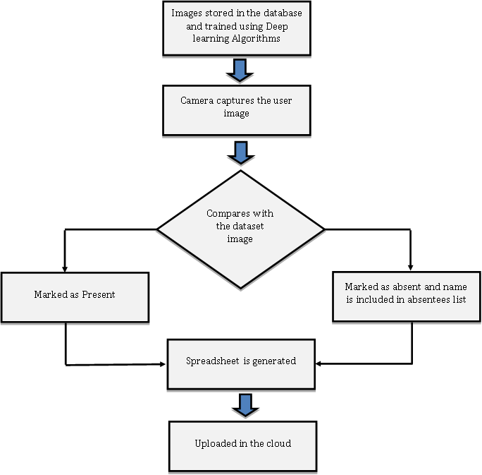
WORKFLOW REPRESENTATION

Slide 7
SYSTEM DESIGN
The Entire project consists of two main sections:
Database Management for Image Acquisition.
Deep Learning Algorithms for Face Recognition.

Slide 8
Database Management for Image Acquisition
For Facial Recognition, Datasets should be in the form of Image.
Photos of Students and Faculties will be collected from them in a regular basis
All the images will be stored in the SQL file. The images will be stored in the BLOB Format. BLOB stands for Binary Large Object. A BLOB is an object data type, meaning it refers to an object. Unlike a character or integer data type, the object data type only contains a pointer or reference to the value of the object. A BLOB can hold a very large block of data, anything from documents to images to videos.

Slide 9
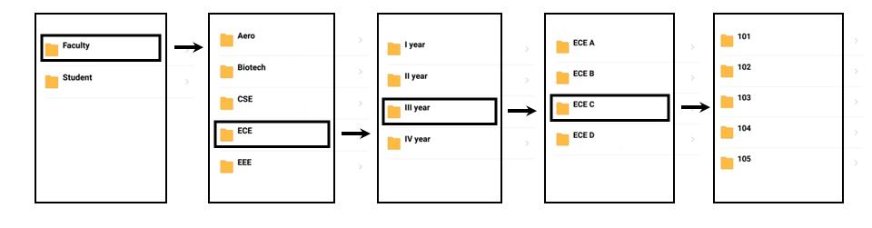
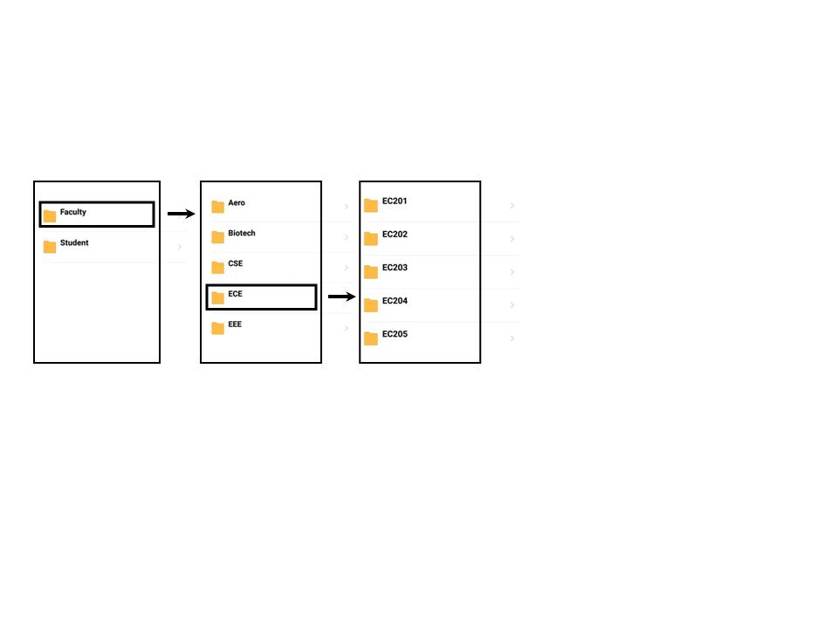
Sample representation of structure of data
Fig. 1 Student Database
Fig. 2 Faculty Database

Slide 10
Deep Learning Algorithms for Face Recognition

Slide 11
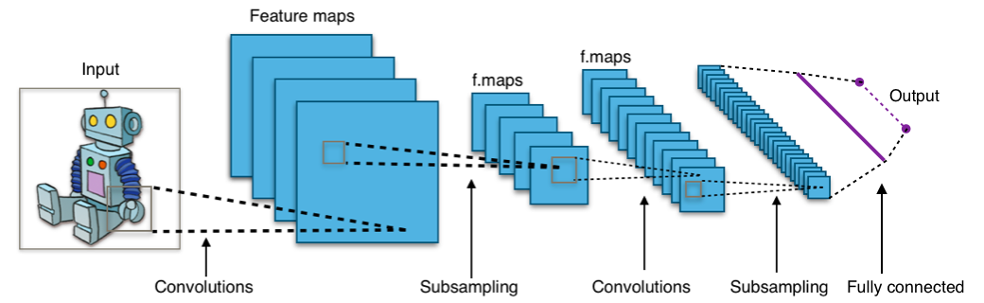
CONVOLUTIONAL NEURAL NETWORK model
Convolution Neural Network (CNN) is named after the convolution process the network does to extract the feature maps.
The input image is converted into a matrix form using the color values of each pixel in the image. This input matrix is then convolved with a filter matrix to get the desired feature map.
After the convolution, the resultant matrix is then non- linearized using the ReLu [Rectified Linear Unit] function in which the negative values will be converted to zero and the positive values will remain unchanged.
The next process is the Pooling process where downsampling takes place to reduce the matrix size. Max Pooling takes the max value in each submatrix to produce a matrix containing only the vital information. This is then vectorized to be fed to the Fully Connected Layer.
The FC layer based on the input matrix values predicts to which label the image belongs to by assigning probability values to each node.

Slide 12
Attendance Portal Application
Attendance Portal
Attendance Portal
Attendance Portal
Enter ID Number
Faculty
Click Here to upload Image
Student
Password

Slide 13
Software requirements
Python is being extensively used in the field of Data Science. Python has become the most preferred language for building Artificial Intelligence and Machine Learning algorithms. The reasons for being the most preferred language are as follows
Extensive set of libraries are available for writing machine learning algorithms. The availability of these libraries makes it easy for the user to build the learning models.
Python has one of the biggest online communities so that the developers can discuss errors and solve each other’s problems.
It is one of the most easily understandable languages such that it almost resembles the English language and hence it is very easy to learn. Other programmers also won’t find it difficult to read one’s code.
Being platform-independent an application developed in python can run on any OS.

Slide 14
HARDWARE REQUIREMENTS
The hardware requirements required for implementing this system are CCTV cameras that are already present in the class, server computer to run the face recognition script.

Slide 15
FINANCial PLAN
The finance requirements for realizing the proposed system is very less.
The CCTV cameras that are already present in the classrooms can be used to capture the images.
The face recognition script can be run on the institution’s server computer.
Hence no money is required as this prototype is concerned.

Slide 16
FUTURE DEVELOPMENT
Improved Algorithm usage for monitoring the behaviour of the students.
Continuous monitoring in the disciplinary action of the students such as Usage of Mobile Phone inside the classroom, Chatting while taking lectures, lying on the desk unnecessarily, etc.
Surveillance and Monitoring the students during examination. To identify students engaging in malpractices such as paper chasing, etc.
Add-On feature for indicating the presence of faculty

Slide 17
THANK YOU

